Slide 1
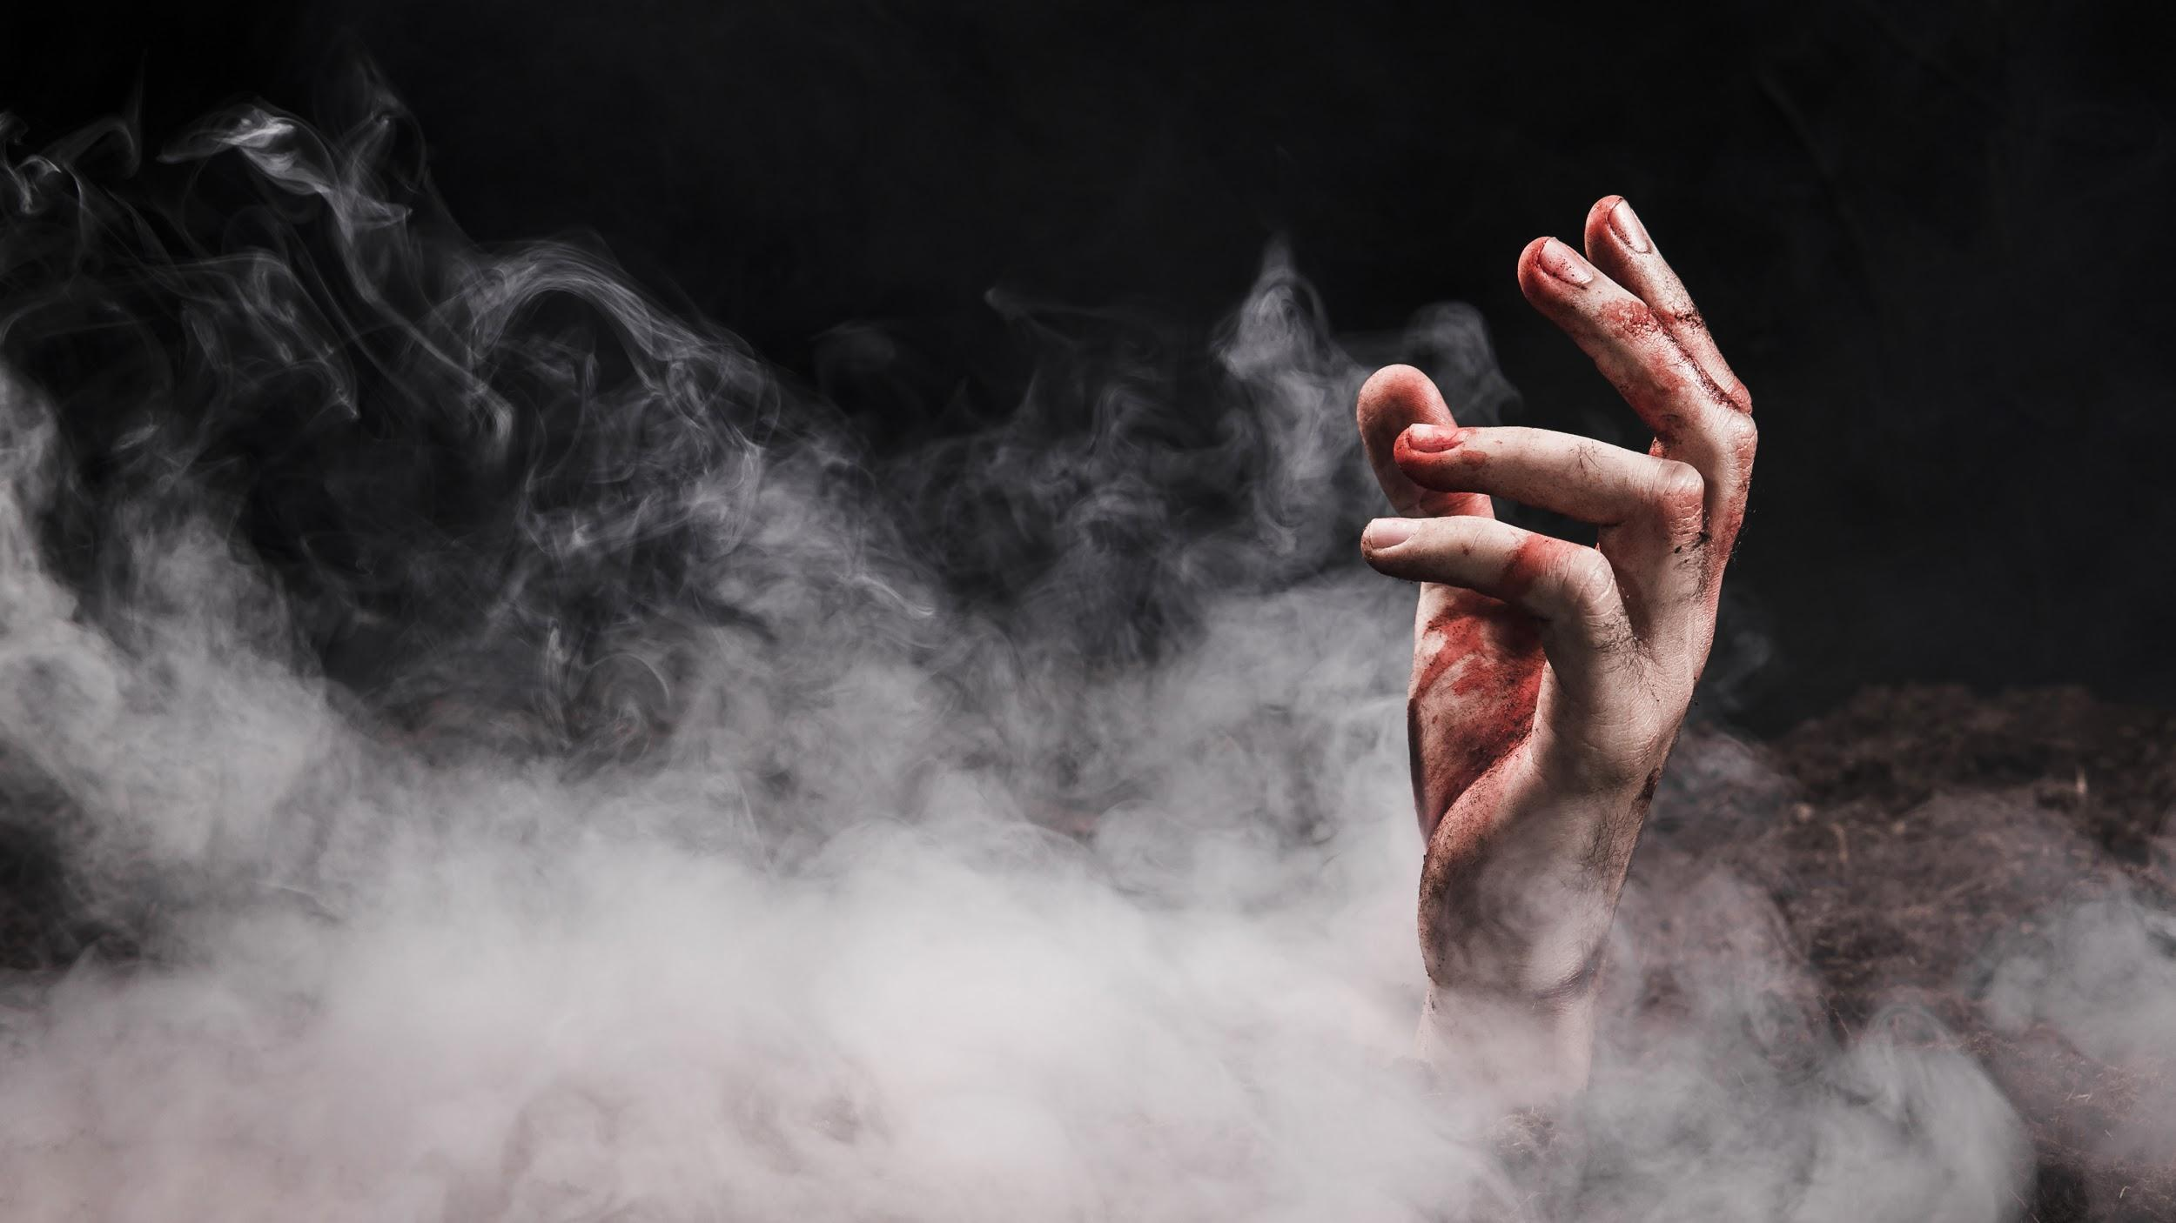
the horror passage
Team GOTH: Becky Matthews-Pease
Rohini Shrivastava
Joyce Woznica

Slide 2
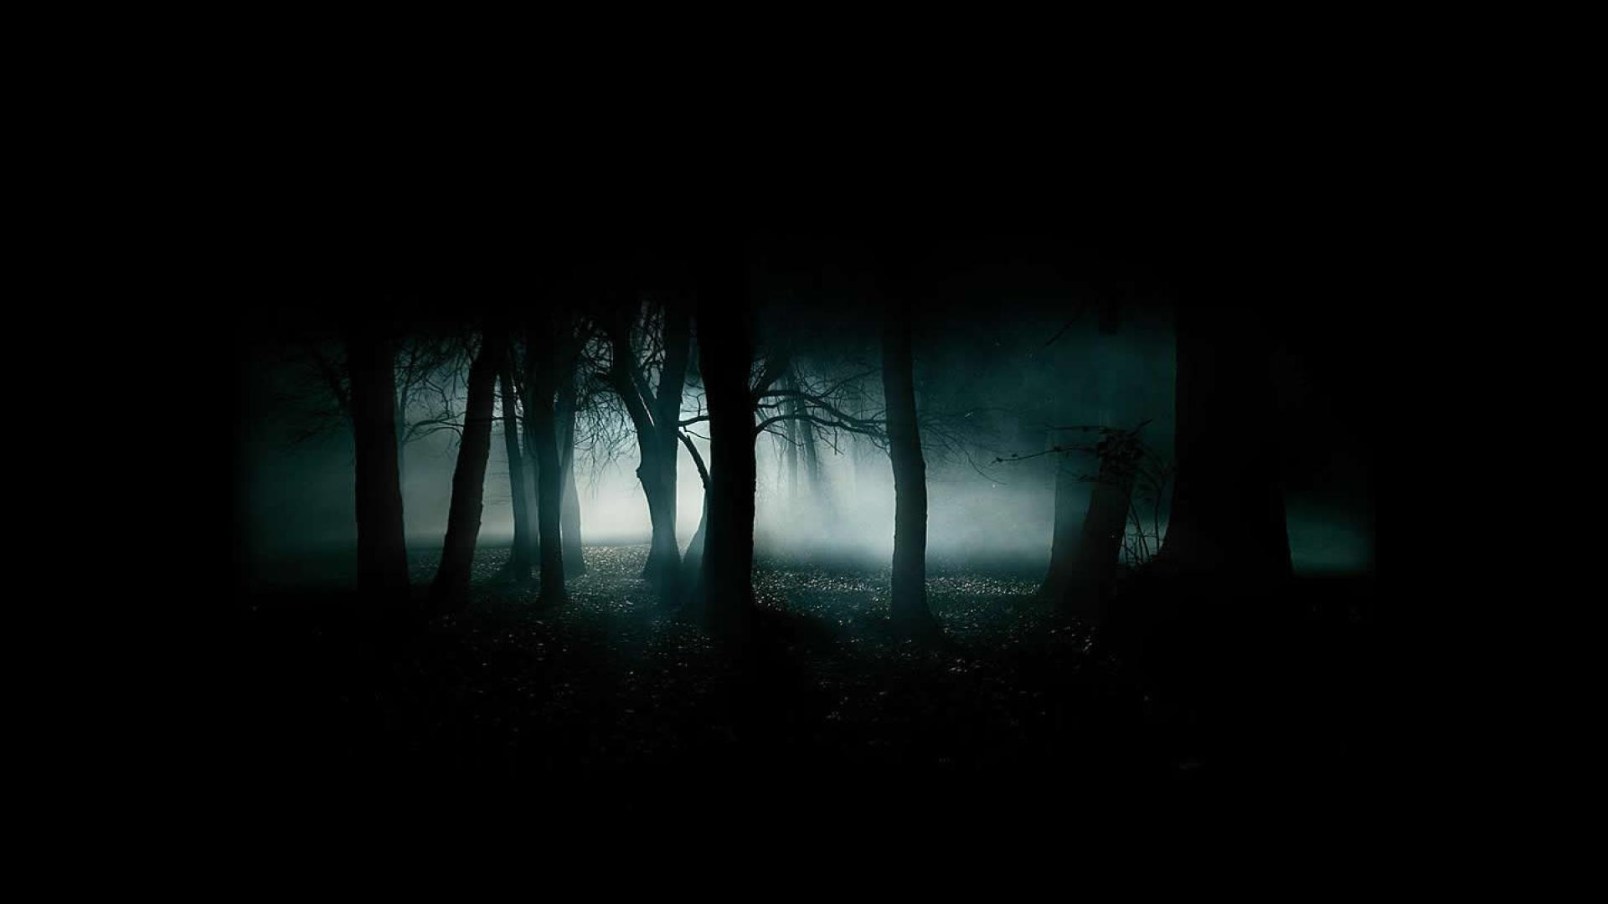
· horror passage project·
01
04
02
06
project definition
models
background
05
results
03
data
conclusion

Slide 3

project definition
01
You can enter a subtitle here if you need it

Slide 4
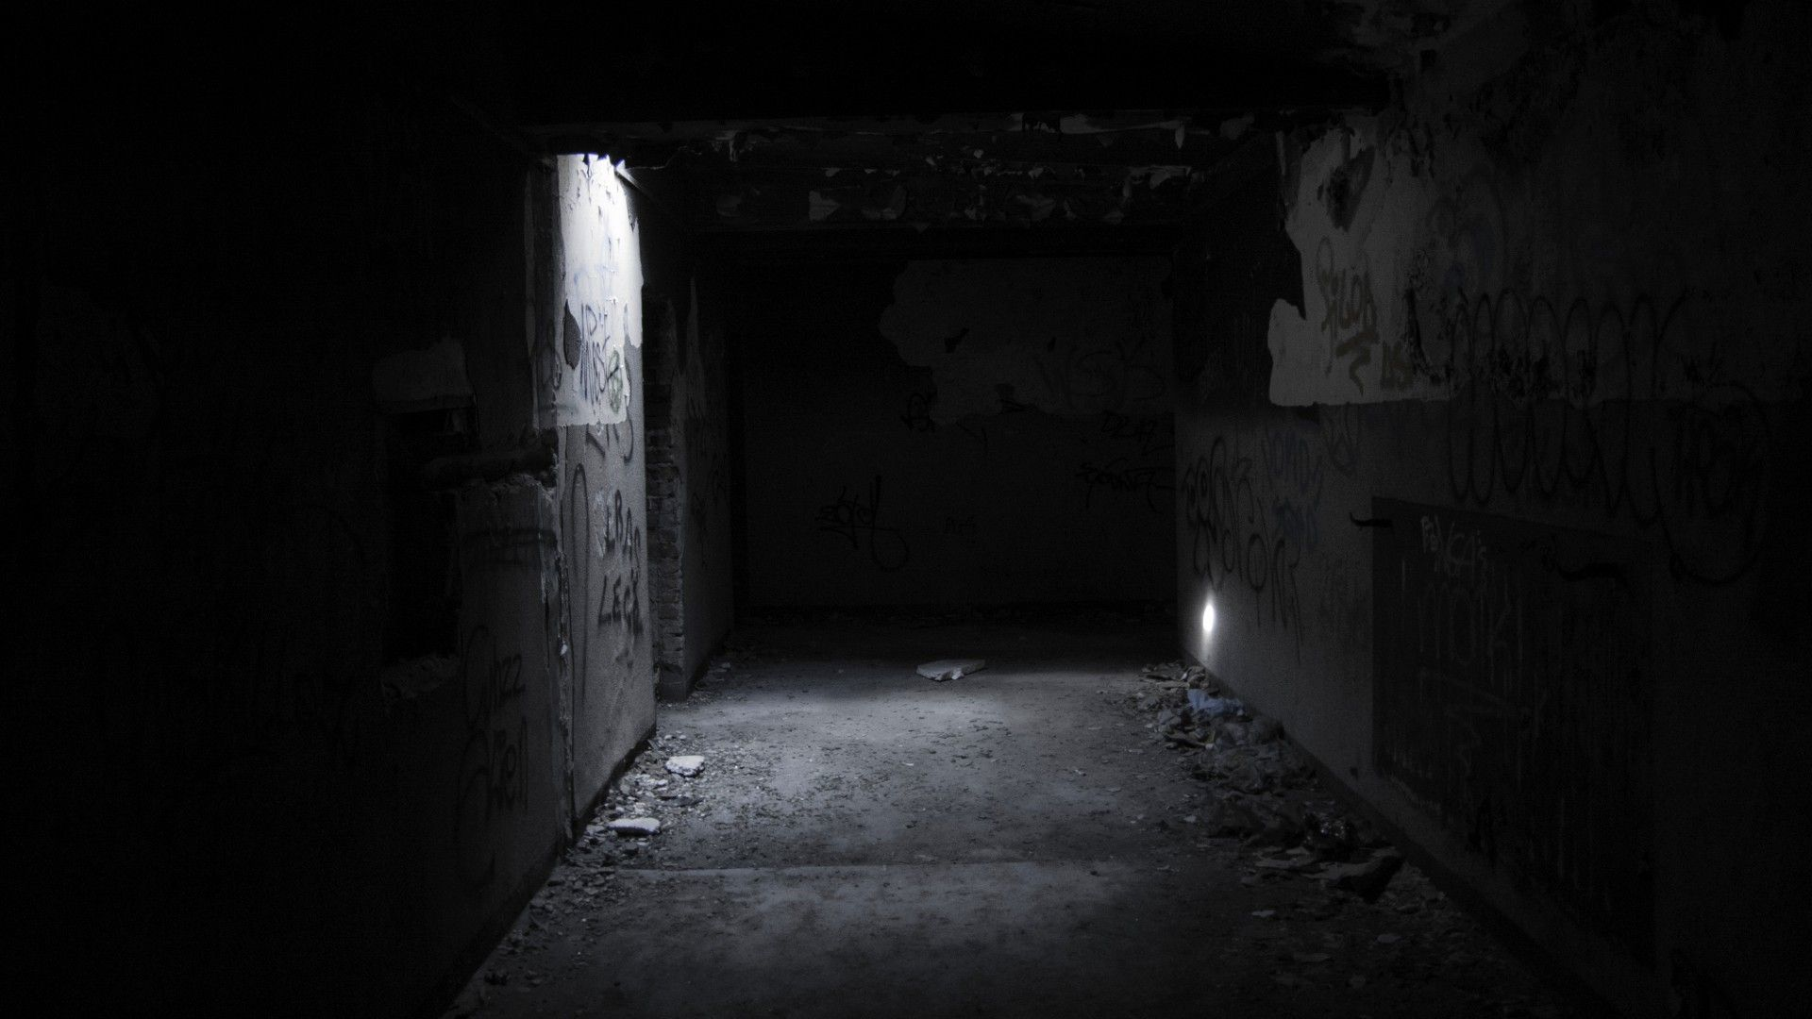
· project definition ·
Horror in fascinating and loved by many
What can be derived from studying these works?
Do horror authors write with uniquely?
Are they influenced by other writers?
Can computers be taught to recognize specific authors?
How do people feel about the horror classics?
And who knows what other spine-chilling ideas . . .

Slide 5
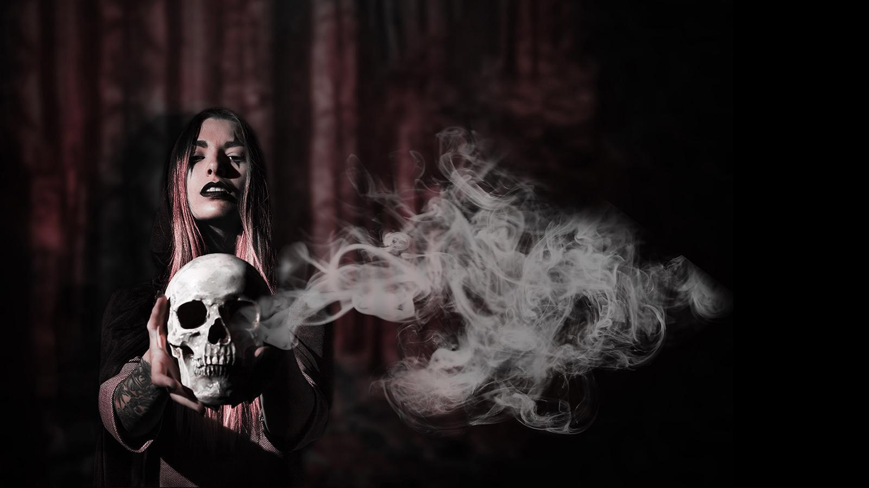
02
background

Slide 6
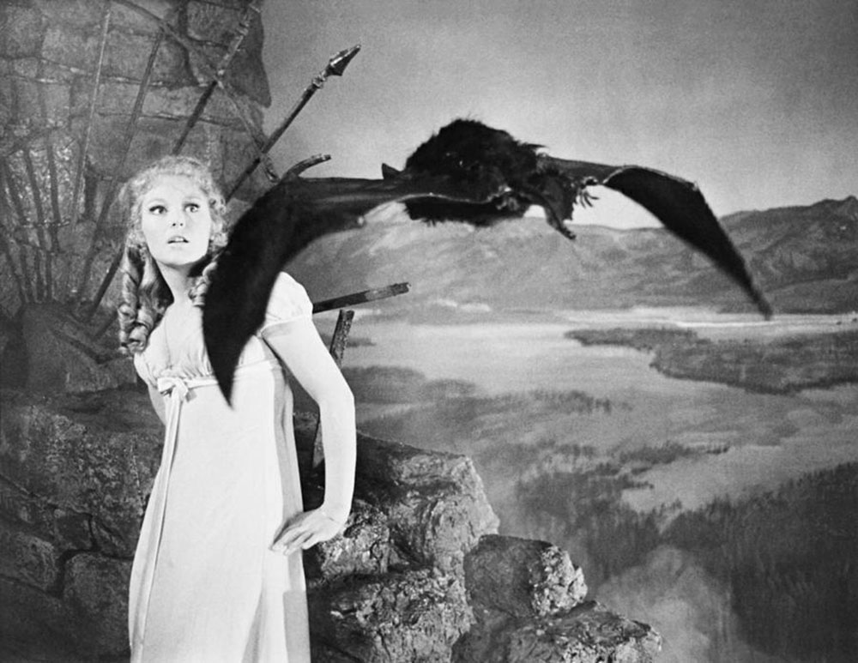
what is gothic horror?
Genre that covers horror, death and romance
Showcases battles between humanity and unnatural evil
Set inside an oppressive, inescapable and bleak landscape
Gives off a feeling of unease and dread

Slide 7
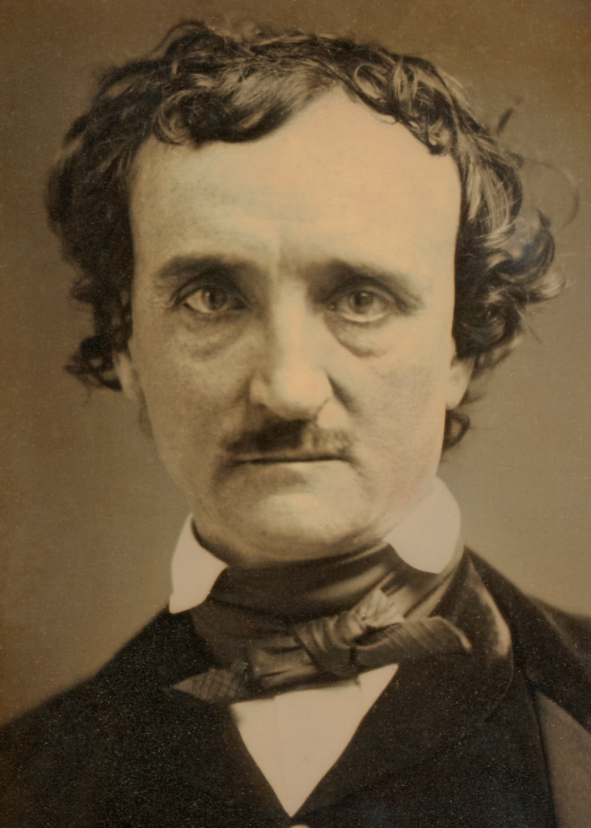
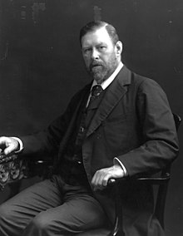
EDGAR ALLAN POE
BRAM STOKER
Born January 19, 1809
Was an American writer, poet, editor, and literary critic
Well known for his poetry and short stories
Considered the inventor of the “Detective Fiction” Genre
Well known works include: The Tell-Tale Heart, The Raven, The Narrative of Arthur Gordon Pym of Nantucket
Born November 8, 1847
Was an Irish author writer
Well known during his lifetime as a PA for Sir Henry Irving
Wrote for multiple different genres including non-fiction
Well known works include: Dracula, Reminiscences of Henry Irving

Slide 8
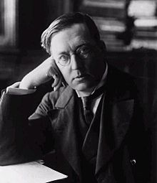
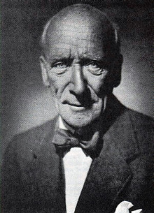
M.R. JAMES
ALGERNON BLACKWOOD
Born on August 1, 1862
English author, medievalist scholar, and Vice-Chancellor at Cambridge
Known as the originator of the “antiquarian ghost story”
Well-known works include: Ghost Stories of an Antiquary, A Thin Ghost and Others, The Malice of Inanimate Objects
Born on March 14, 1869
English novelist, broadcasting narrator
Most prolific ghost story writer of the genre
Well-known works include: The Doll and One Other, The Starlight Express, John Silence

Slide 9
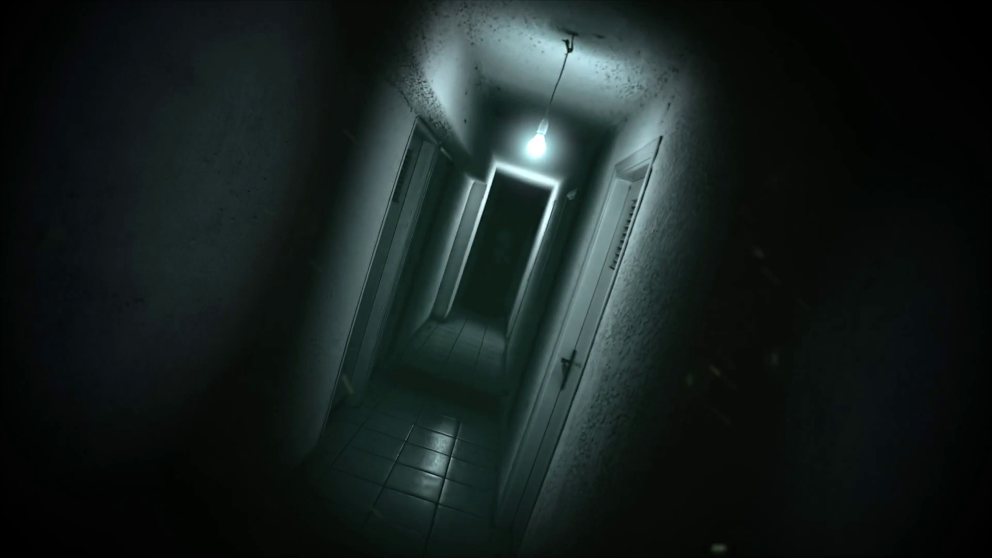
03
data

Slide 10
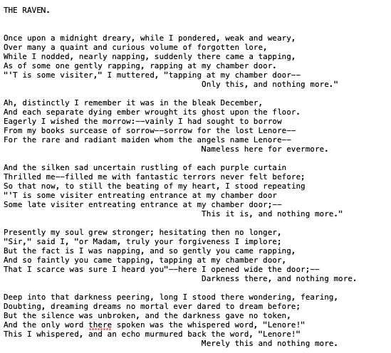
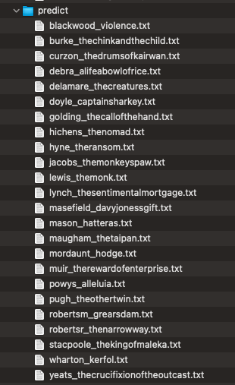
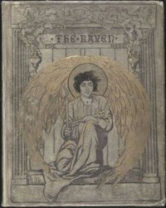
· book data ·
Raw book text
Publishing data via API
Author Reviews and Ratings
Notes:
The data included the raw book text from Project Gutenberg which required quite a bit of cleanup - removing strange characters, preface and terms and conditions of use.
Between 15 and 17 books were obtained for the four authors mentioned to provide a balanced dataset.
In addition, 26 additional works were obtained to review how authors may have been influenced by some of the greats.
In addition to the books, publishing data about the books as well as author ratings and reviews were used to round out the data.

Slide 11
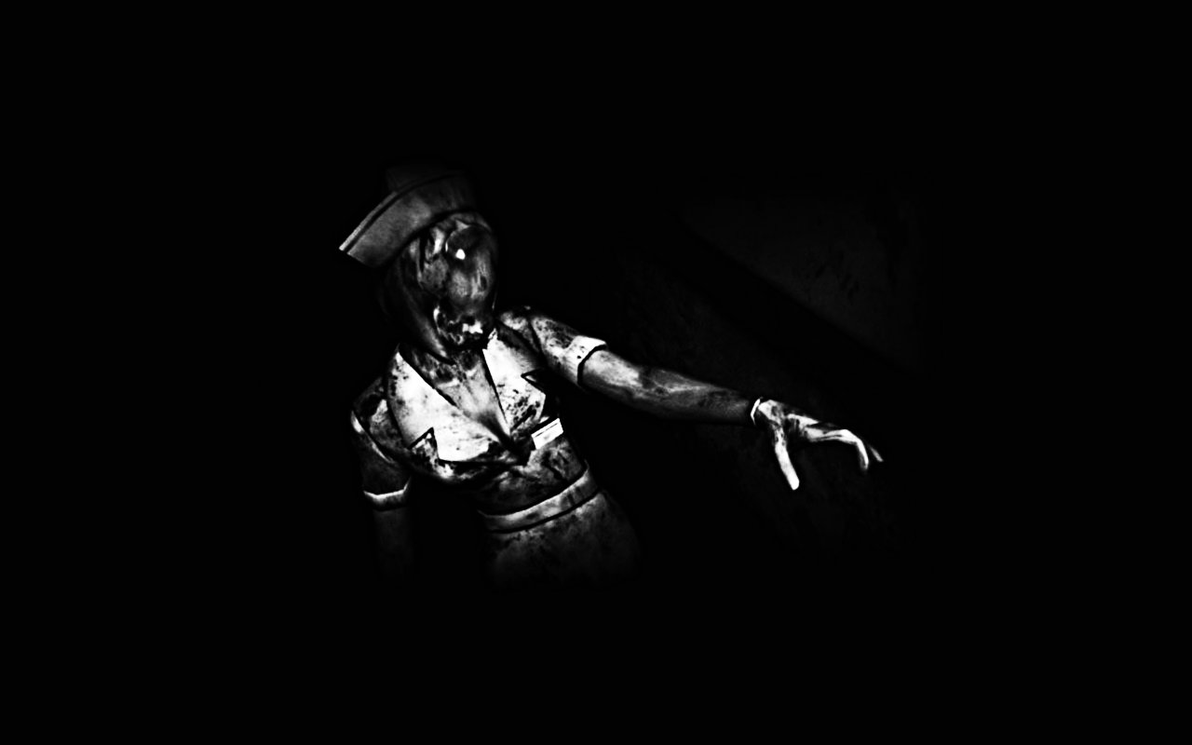
04
models
Notes:
On to the modeling . . .

Slide 12
· models ·
Naïve Bayes
Many variations
Support Vector Machines
LDA Topic Modeling
Sentiment Analysis
 | 10-fold Cross Validation
 | CountVectorizer Vectorization | TfidfVectorizer Vectorization
Classifier Feature Set | Mean Accuracy
Multinomial Naïve Bayes | 86.67% | 43.33%
Bernoulli Naïve Bayes | 70% | N/A
SVM Linear Kernel | 90% | 93.33%
SVM RBF Kernel | 81.67% | 33.33%
SVM Polynomial Kernel | 65.00% | 11.67%
 | Single 75/25 Run
 | CountVectorizer Vectorization | TfidfVectorizer Vectorization | CountVectorizer with Stemmer
Classifier Feature Set
Multinomial Naïve Bayes | 88.23% | 47.06% | 88.23%
Bernoulli Naïve Bayes | 76.47% | N/A | N/A
Multinomial Naïve Bayes (Unigram, Bigrams) | 23.53% | N/A | N/A
Multinomial Naïve Bayes (Bigrams, Trigrams) | 52.94% | N/A | N/A
SVM Linear Kernel | 100% | 82.35% | N/A
SVM RBF Kernel | 70.59% | 5.88% | N/A
SVM Polynomial Kernel | 58.82% | 5.88% | N/A
Notes:
To approach exploring gothic horror writers and their works, different modeling techniques were used in combination with various vectorization and stemming.
This information helped to determine if gothic horror writers tend to write similarly or if their writings are unique and if computer models can predict the author of a work simply by reviewing the vocabulary used in that work.
Modeling using Naïve Bayes - multinomial, unigrams and bigrams, bigrams and trigrams as well as Bernoulli Naïve Bayes were executed.
In addition, Support Vector Machines with various kernels and costs were executed
As shown in these tables, there were some models that performed at a high level of accuracy. Particularly, Multinomial NB, Bernoulli NB and most importantly SVM with the Linear Kernel.
Surprisingly, unigrams, bigrams and trigrams performed quite poorly in the 25 to 50% range. It was expected that combinations of words might raise the level of accuracy but this did not happen.
To confirm the best performing models and to determine if serious overfitting was happening with SVM and the linear kernel, 10-fold cross-validation was executed on several models.
As seen in this table, multinomial NB still performed well as did SVM with a slight overall reduction in performance.
In addition to these models, the authors’ works were reviewed with Latent Dirichlet allocation (LDA) topic modeling and Valence Aware Dictionary for Sentiment Reasoning (VADER) Sentiment Analysis was used to review how these authors were perceived by the reading public.

Slide 13
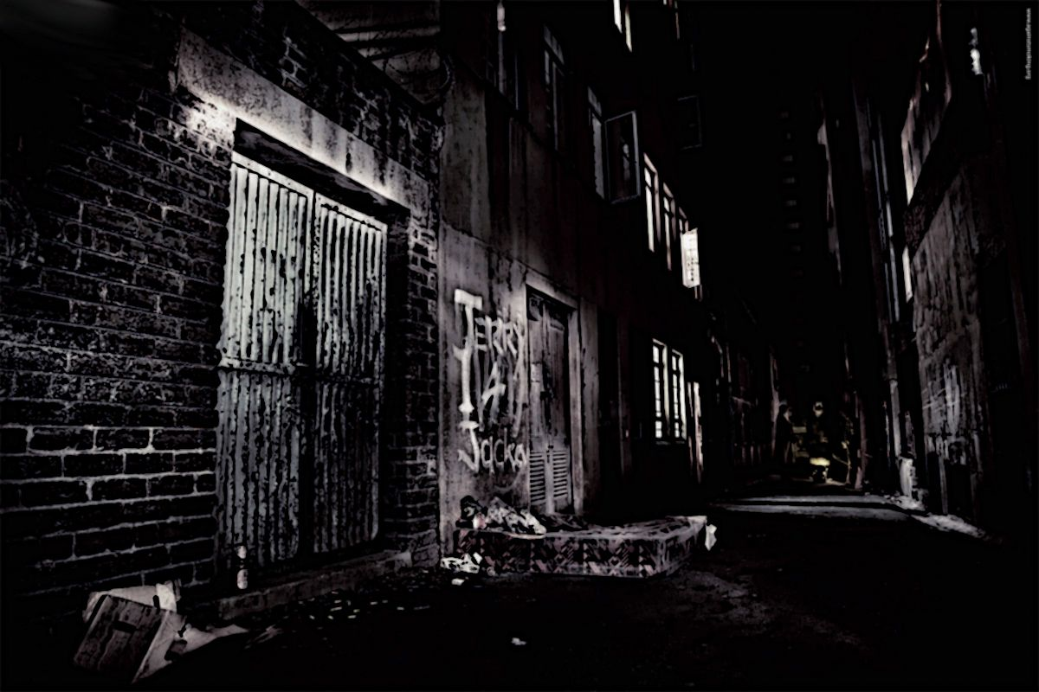
05
results
Notes:
After running these models, the results were visualized . . .

Slide 14
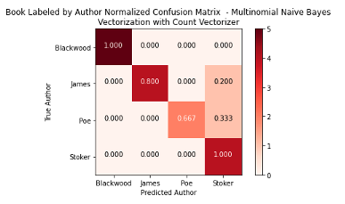
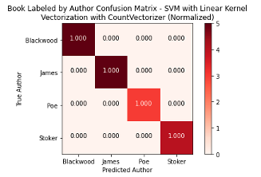
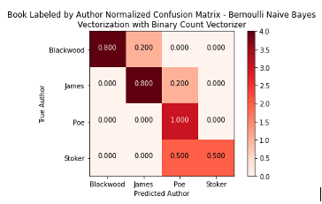
· high performing model results ·
Notes:
These confusion matrices show the high level of accuracy for each of the highest performing models. The strength of prediction is indicated by the darker squares.

Slide 15
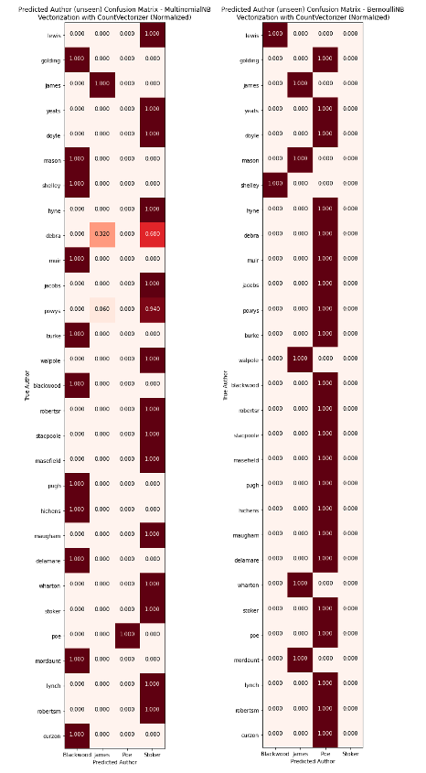
· writer influence results ·
Notes:
In order to review writer influence, it was important to understand when each writer lived and when each was published as indicated in the line graph on the left.
Then the models were released on the “unseen author” group - the fresh and unseen group of works including one work from each of the original 4 authors.
As shown on the right, the multinomial NB model predicted the four original authors perfectly. It did indicate that many of the authors used similar vocabulary to that of Blackwood and Stoker.
Ironically, the Bernoulli NB model did a very poor job - incorrectly predicting: Blackwood and Stoker and essentially implying that Poe had the most influence on the other authors.
Poe did write a decade before many of these authors and Stoker published around the same time.
Some Interesting results were those of the authors that lived and wrote in a much earlier period:
Mary Shelley, author of Frankenstein – was predicted as Algernon Blackwood - maybe the influence went the other direction - Shelley influenced Blackwood?
M. G. Lewis, author of The Monk – was predicted as Bram Stoker
Horace Warpole, the earliest published author in the group, author of The Castle of Oranto – was predicted as Bram Stoker
Although May Shelley and Edgar Allen Poe wrote during a similar era, their works remain very different.

Slide 16
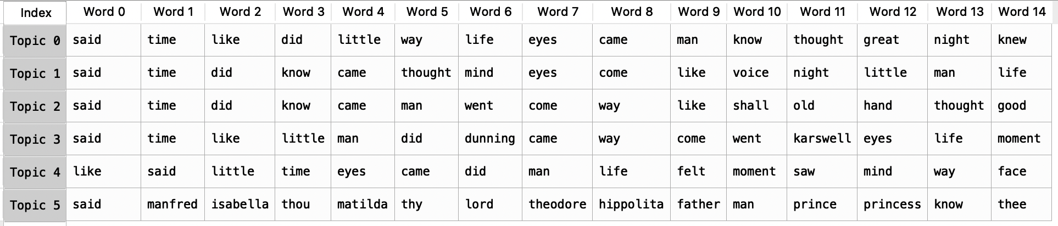
· book topics ·
Notes:
Although six book topics were derived from the selected of all authors - the original four and all in the extra 26 works, only 4 were seen as significant - clearly Topic 2 and Topic 4 were the most common amongst the writers.
The visualization showing the topics and models and the probability that the work falls into that topic can be seen in the lower left. Although almost 20 books were used for Algernon Blackwood, they all were noted as 100% probability that they were about Topic4 as indicated by the single dot. The other four original authors show a range of topics and varying probabilities.

Slide 17
· author reviews and ratings ·
Notes:
It was important to see how readers feel about these authors. Fifteen reviews were found for each of the original authors and reviewed for ratings and sentiment.
As indicated on the left - the ratings were widely spread from 1 to 5 (5 being the highest); however, Blackwood and James were clearly higher rated overall than the other two authors.
As expected, as the rating number got larger, there was more positive sentiment in the review - this is a good reassurance that the model is likely doing a good job with sentiment.
Finally, the sentiment for each author was plotting using red to green (similar to the first bar chart) with green being the most positive and red being the most negative. Again, Blackwood jumps to the top with Poe and James creepy up behind him.

Slide 18
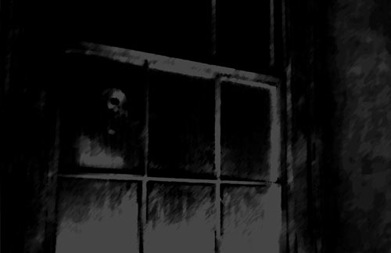
06
conclusion

Slide 19
· conclusion ·
Very accurate in determining who wrote what
Most influential were Blackwood, Stoker and Poe
Poe influenced Blackwood and James works
Stoker influenced James
Blackwood and Poe shared similar vocabulary

Slide 20
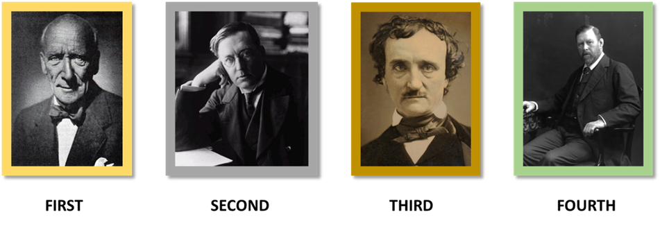
· writing olympics ·
Blackwood
Rating: 5 ”He slowly draws the reader into a downward spiral of dread and terror. This ability to arouse and sustain terror is what is truly remarkable about Blackwood’s writing.”
James
Rating: 5 ”Understated creepiness at its best.”
Poe
Rating: 5 ”I love Edgar Allen Poe - what a storyteller!”
Stoker
Rating: 5 ”I am obsessed. This was bloody fantastic (pun intended).”
Notes:
The gold medal goes to Algernon Blackwood followed by M.R. James and Edgar Allen Poe. Honorable Mention to Bram Stoker.
Some memorable ratings and reviews

Slide 21

thank you!

Slide 22
· resources ·
We have used the following resources to bring you the horror passage this evening . . .
Wikipedia https://en.wikipedia.org
The Gutenberg Project http://www.gutenberg.org/
Goodreads https://www.goodreads.com/
Internet Archive https://archive.org

